Slide 1



Amazon Sales Analysis
View in Power BI
Last data refresh:
17-12-2022 12:21:17 UTC
Downloaded at:
17-12-2022 13:12:38 UTC

Slide 2
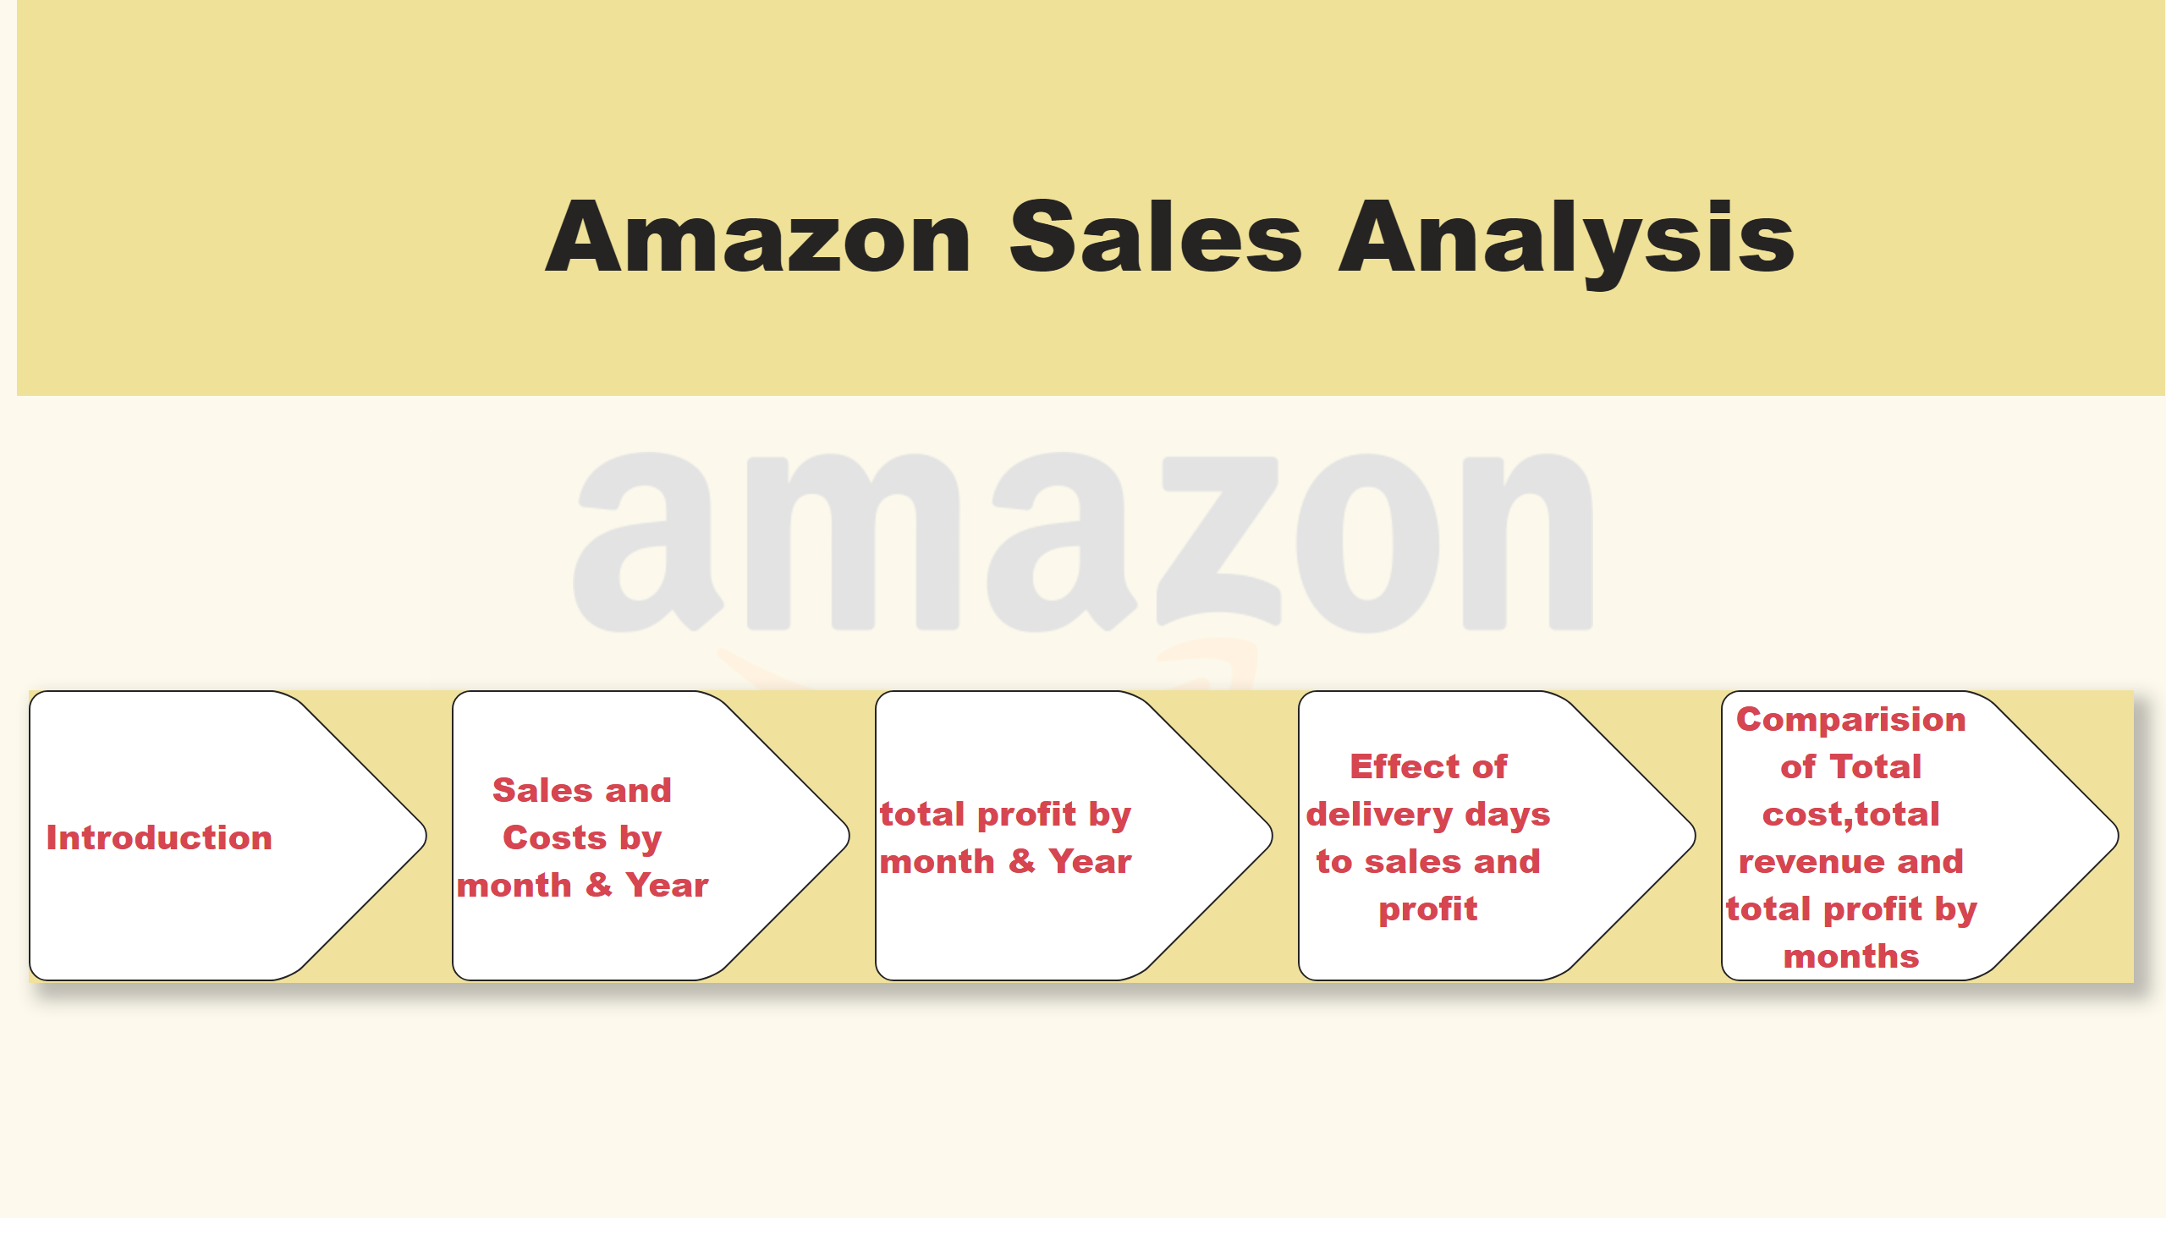
Index
Notes:
textbox
No alt text provided
pageNavigator
No alt text provided

Slide 3
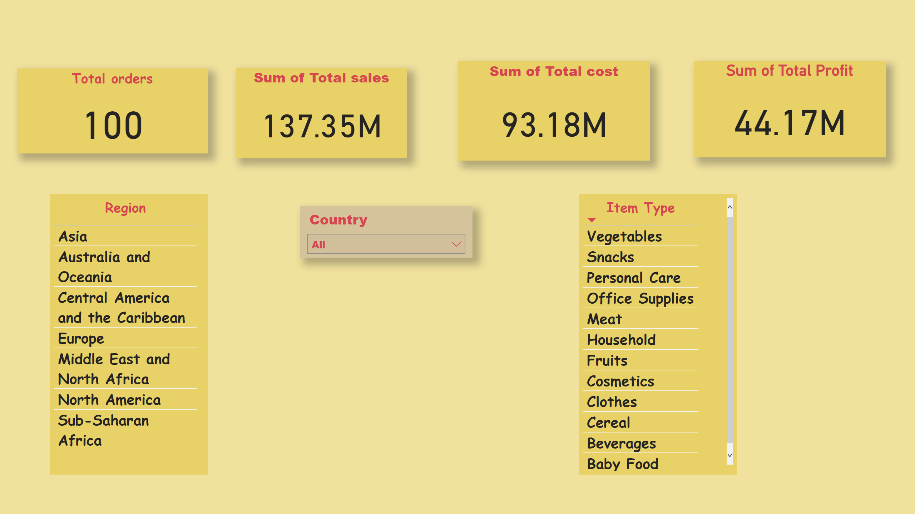
Introduction
Notes:
Sum of Total sales
No alt text provided
Sum of Total Profit
No alt text provided
Sum of Total cost
No alt text provided
slicer
No alt text provided
tableEx
No alt text provided
tableEx
No alt text provided
Total orders
No alt text provided

Slide 4
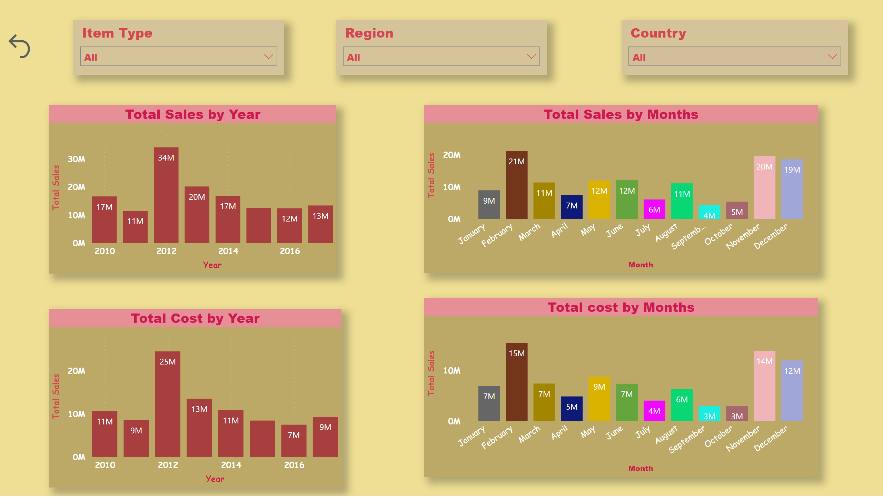
Sales and Costs by month & Year
Notes:
slicer
No alt text provided
Total Sales by Year
No alt text provided
Total Cost by Year
No alt text provided
Total Sales by Months
No alt text provided
slicer
No alt text provided
slicer
No alt text provided
actionButton
No alt text provided
Total cost by Months
No alt text provided

Slide 5
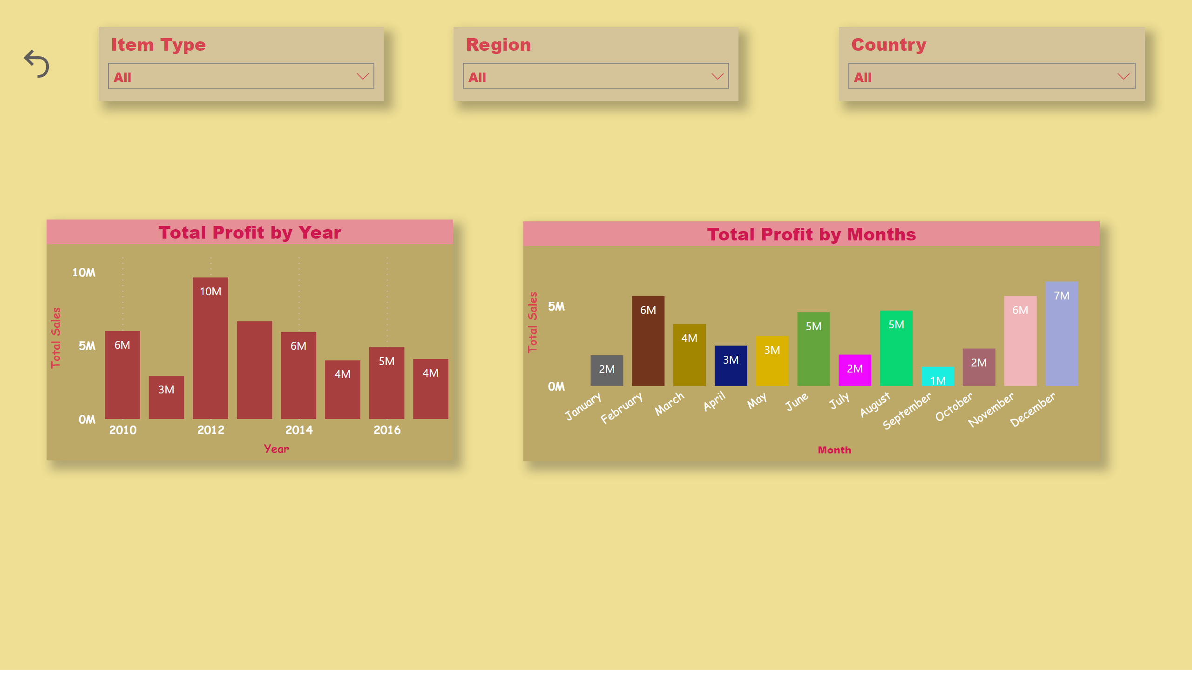
total profit by month & Year
Notes:
slicer
No alt text provided
slicer
No alt text provided
actionButton
No alt text provided
slicer
No alt text provided
Total Profit by Months
No alt text provided
Total Profit by Year
No alt text provided

Slide 6
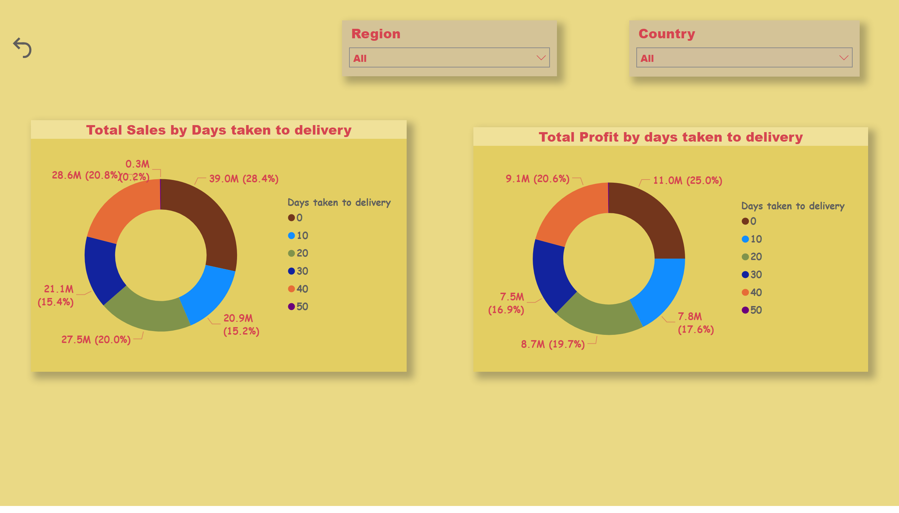
Effect of delivery days to sales and profit
Notes:
slicer
No alt text provided
slicer
No alt text provided
actionButton
No alt text provided
Total Sales by Days taken to delivery
No alt text provided
Total Profit by days taken to delivery
No alt text provided

Slide 7
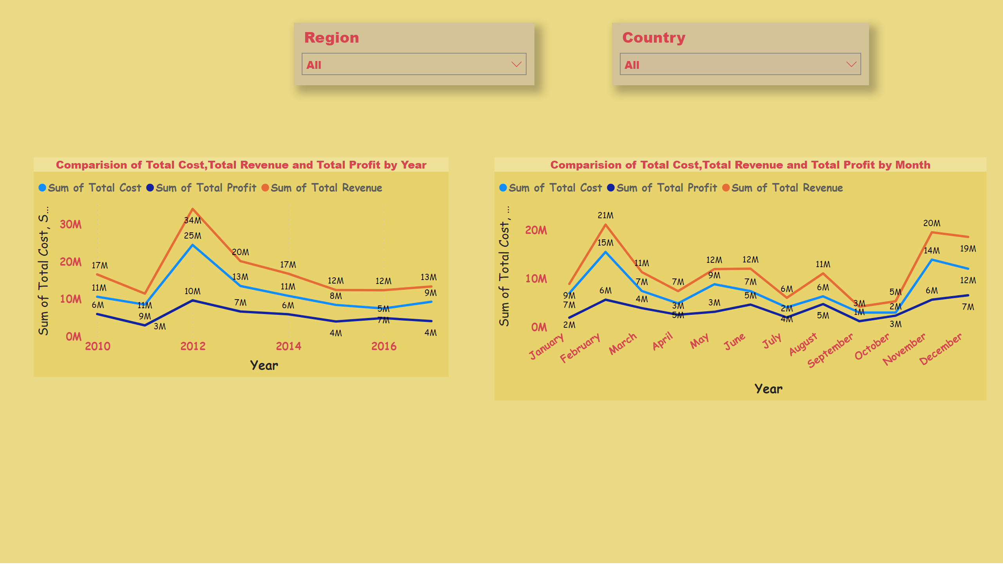
Comparision of Total cost,total revenue and total profit by months
Notes:
slicer
No alt text provided
slicer
No alt text provided
Comparision of Total Cost,Total Revenue and Total Profit by Month
No alt text provided
Comparision of Total Cost,Total Revenue and Total Profit by Year
No alt text provided

